Slide 1

Firmware Analysis CSCE-660
Stephen Dunlap, CISSP
stephen.dunlap.ctr@afit.edu
This briefing, presentation, or document is for information only.
No US Government commitment to sell, loan, lease, co-develop
or co-product defense articles or provide defense services is implied or intended

Slide 2
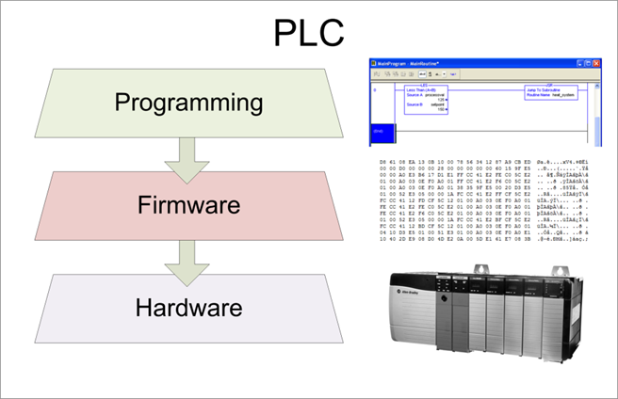
Controllers
Control and monitor physical components of systems
Hardware Layer
Physical components of PLC
Firmware Layer
Layer between the program and hardware layers
Handles the communication between layers
Operating System
Programming Layer
Programmed in ladder logic
Structured text
Function block diagrams
Slowly moving towards modern languages

Slide 3
Goal
Modify firmware and install it on a device
Problem:
Device will only accept vendor firmware
Any modifications cause update to fail
Tips
Be prepared to brick a couple devices
Take good notes as you RE!!
Don’t be intimidated
Do be stubborn

Slide 4
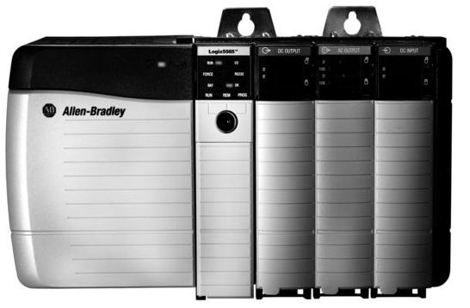
AB ControlLogix

Slide 5
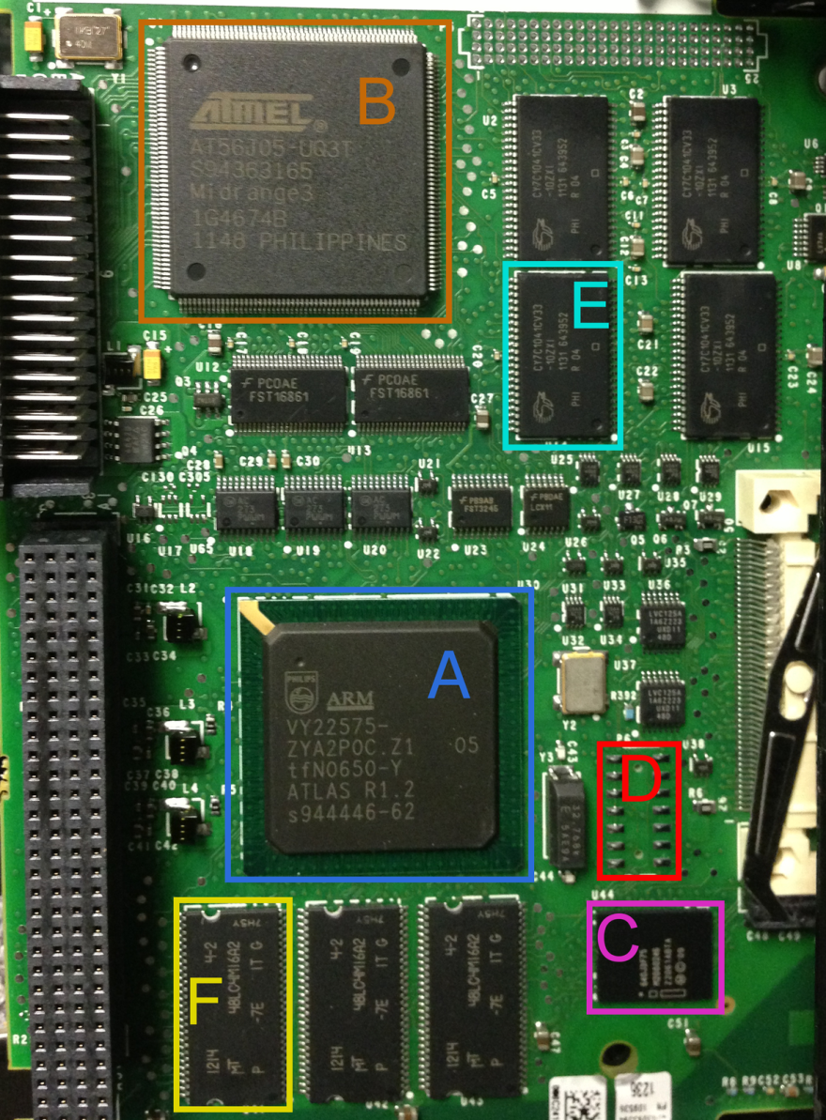
AB ControlLogix

Slide 6
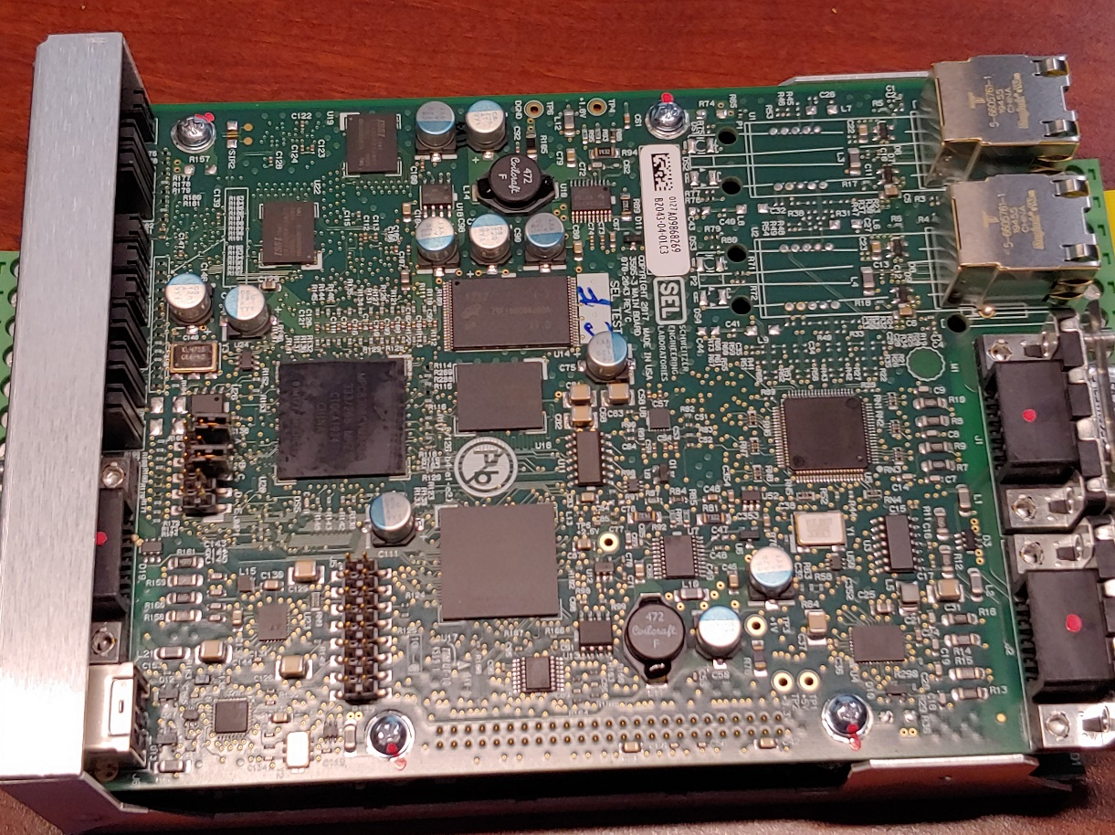
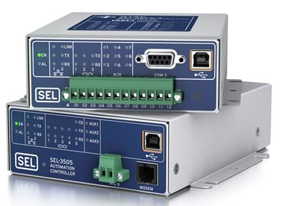
SEL RTAC

Slide 7
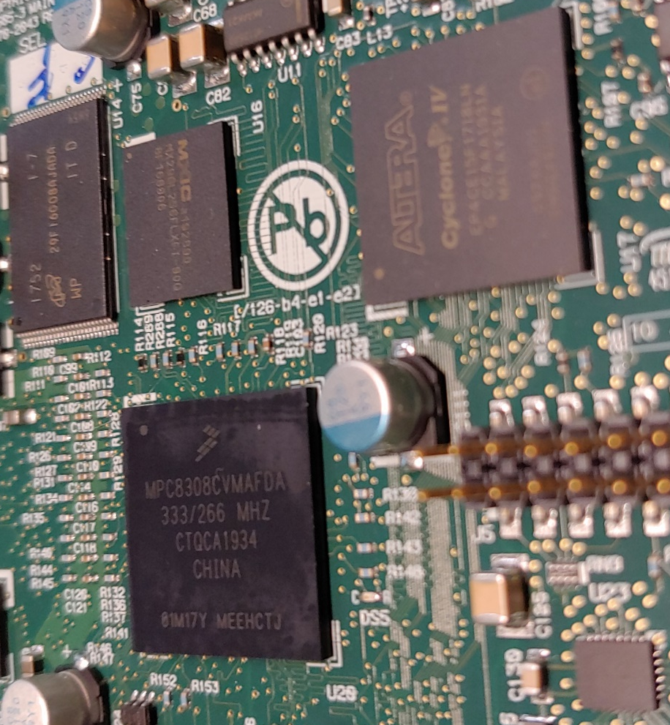
SEL RTAC

Slide 8
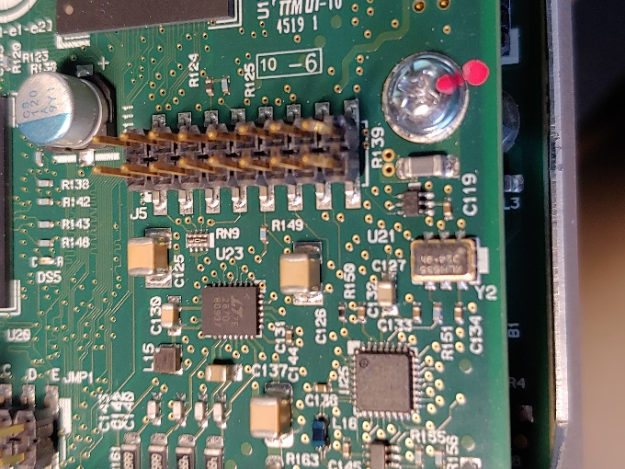
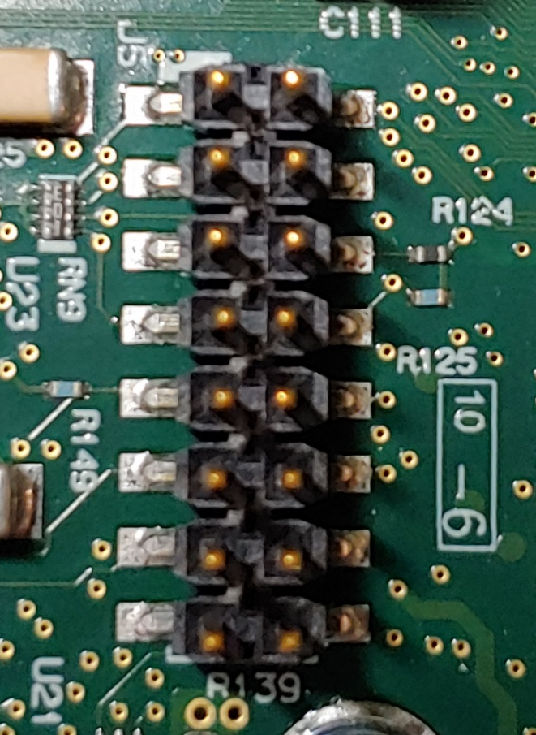
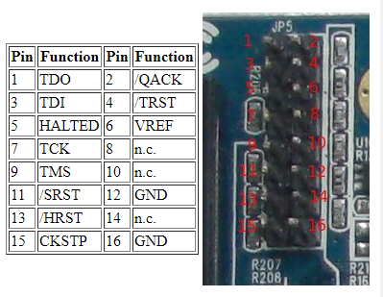
SEL RTAC
?
?
?
?
?
?
?
?
?
?
?
?
?
GND
?
GND
http://sun.hasenbraten.de/~frank/docs/mpc824x_JTAG.html

Slide 9
Necessary Information
Architecture (ARM, MIPS, PowerPC)
Firmware format (compression, RTOS, FS)
Memory map (base address of FW, stack, heap)
Entry point (boot loader, main firmware)
Integrity checks (Checksums, CRCs, hashes, signatures)

Slide 10
Familiarization
Use the device the way it was intended
Use Wireshark
Run nmap
Look for interesting files

Slide 11
Acquire Firmware
Vendor webpage
Update utility
Customer support
Extract binary image from installer
Wireshark
Hardware extraction
Process will vary among devices/vendors

Slide 12
Binary Analysis Tools
Strings
Hex Editor
Bindiff
Binwalk
Visualization

Slide 13
Binary Analysis Tools - strings
Human-readable clues
Things to look for:
Copyrights
Filenames
Debug Messages
Compiler info
Passwords
Keys
$ strings firmware.bin | less

Slide 14
Binary Analysis Tools - Hex Dump
What’s in the file?
Things to look for:
Headers/Footers
Patterns
Opcodes
Container format
Endianness
String tables
$ hd firmware.bin | less
$ bless firmware.bin

Slide 15
Binary Analysis Tools - vbindiff
Changes between versions
Compare minor versions
Checksums
Length fields
Headers
Version number/string
Compare major versions
Common fields
Length fields
$ vbindiff fw1.bin fw2.bin

Slide 16
Binary Analysis Tools - Binwalk
Known data structures/formats
Things to look for:
File headers
File systems
Compressed data
Images
Opcodes (-A)
Encryption keys/certs
Beware of false positives
# Search for signatures
$ binwalk firmware.bin
# Extract nested files
$ binwalk –e firmware.bin
# Graph entropy
$ binwalk –E firmware.bin

Slide 17
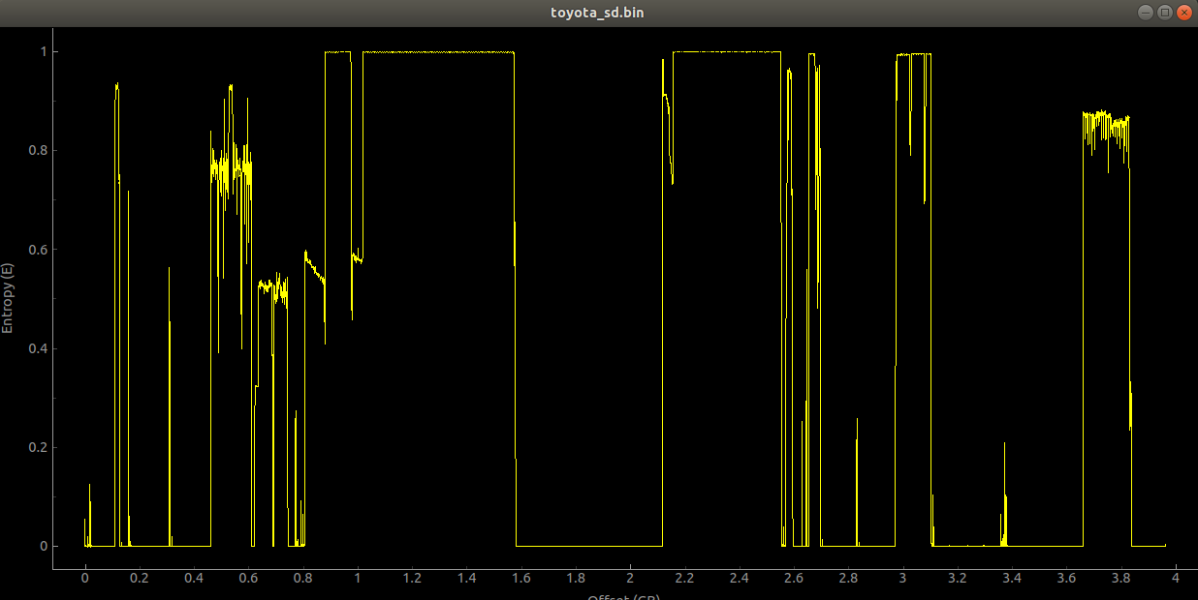
Entropy Graphs
binwalk –E toyota_sd.bin

Slide 18
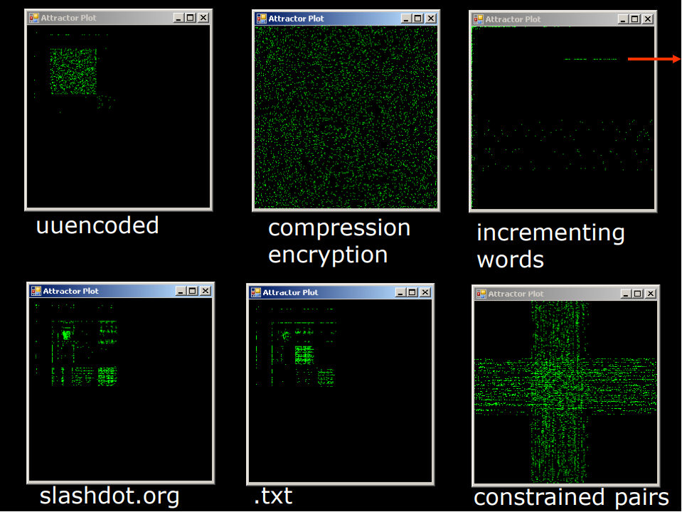
Visualization

Slide 21
Questions

